Slide 1

Smart Home Guardian: Intelligent Home Security System
Smart Home Guardian is an advanced, Python-based home security solution.
It offers intelligent protection with real-time monitoring and threat assessment.
This system integrates cutting-edge technology to safeguard your home and family.
by Nader Mohamed , Mohamed Shoaib and Ammar Gammal

Slide 2

Addressing Home Security Challenges
Evolving Threats
Complex Needs
Traditional security systems often lack proactive threat detection.
Homeowners need comprehensive security that adapts to their lifestyle.
Smart Home Guardian addresses these challenges effectively.
Our system provides customizable solutions for unique requirements.
We solve these modern issues using cutting edge technology

Slide 3
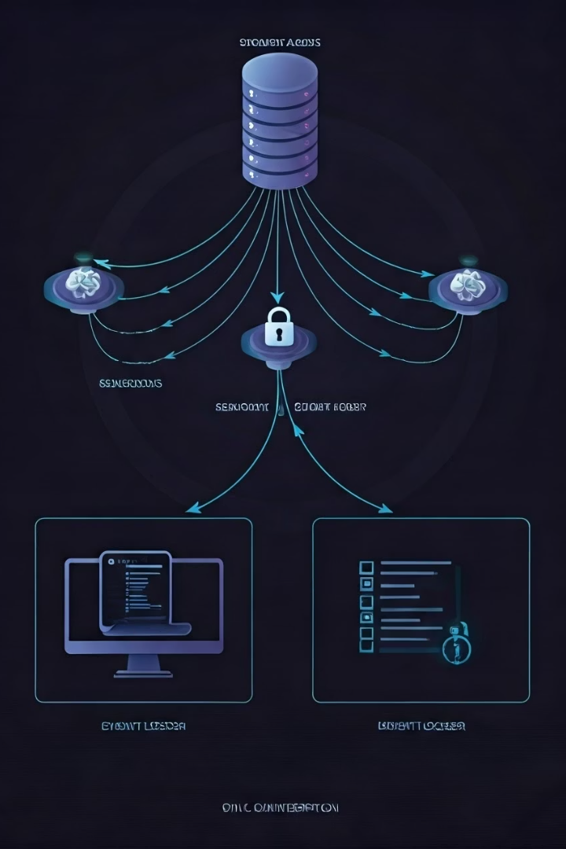




System Architecture Overview
Sensors
Detect motion and entry points.
Security Agent
Analyzes sensor data and triggers alerts.
Event Logger
Maintains a detailed record of all security events.
User Interface
Provides real-time monitoring and control.

Slide 4




Key Features and Benefits
Motion Detection
Real-time detection of unauthorized movement.
Threat Assessment
Intelligent analysis of potential threats.
Event Logging
Detailed record of security events.

Slide 5
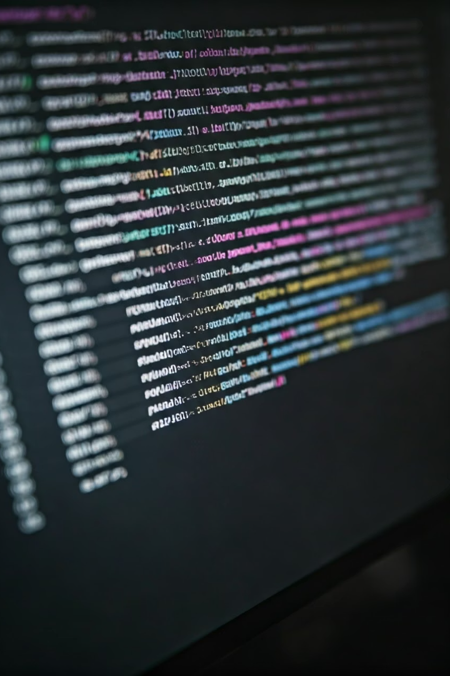
Technical Implementation Details
Multi-Threading
Ensures smooth concurrent operations.
Observer Pattern
Efficient event handling and notifications.
Database Integration
Robust data storage and retrieval.
Modern UI
User-friendly interface for easy control.

Slide 6
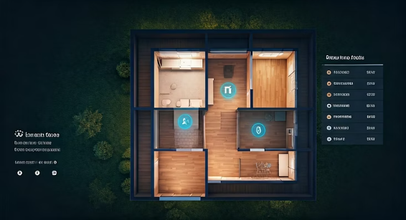
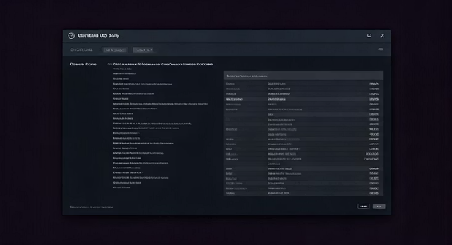
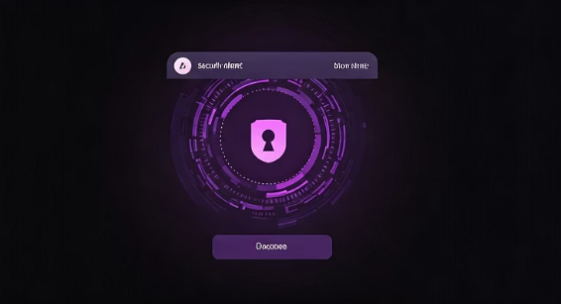
Live Demo: Interface Screenshots
The user interface displays real-time data.
Quickly view event logs and set notifications.

Slide 7
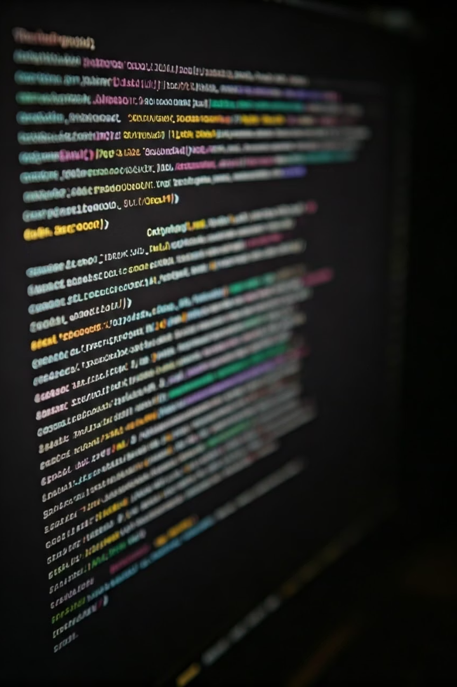
Code Highlights: Thread Safety
Thread-Safe Operations
Sensor Implementation
Implemented locks to prevent data corruption.
Clean, efficient sensor data processing.
Database Integrity
Ensured data consistency and reliability.

Slide 8



Future Enhancements & Conclusion
ML Pattern recognition
1
Smart anaytics of security threats
IoT Integration
2
Expand device support
Remote Monitoring
3
Access control from anywhere
Smart Home Guardian provides advanced, intelligent home security and will only improve over time with expanded IoT integration.

Slide 9
Thank You

